Slide 1


Slide 2

Today
Check in
Project Iteration 02
Goals
Understand process for traversing trees
Project Iteration 02 Design

Slide 3
Recursion Lab
2. Fix the issue in the following code
public static int countdown(int n){
if (n == 0){
System.out.println("Blast off!");
}
System.out.println(n);
countdown(n - 1);
}
1. What prints
public static void mystery(int n){
if (n <= 0){
Return;
}
System.out.print(n + " ");
mystery(n - 1);
System.out.print(n + " ");
}
public static int badRecursion(int n){
if (n == 1){
return 1;
}
return n * badRecursion(n - 2);
}
3. Write pseudocode for a recursive method that prints all elements of an array backward.

Slide 4
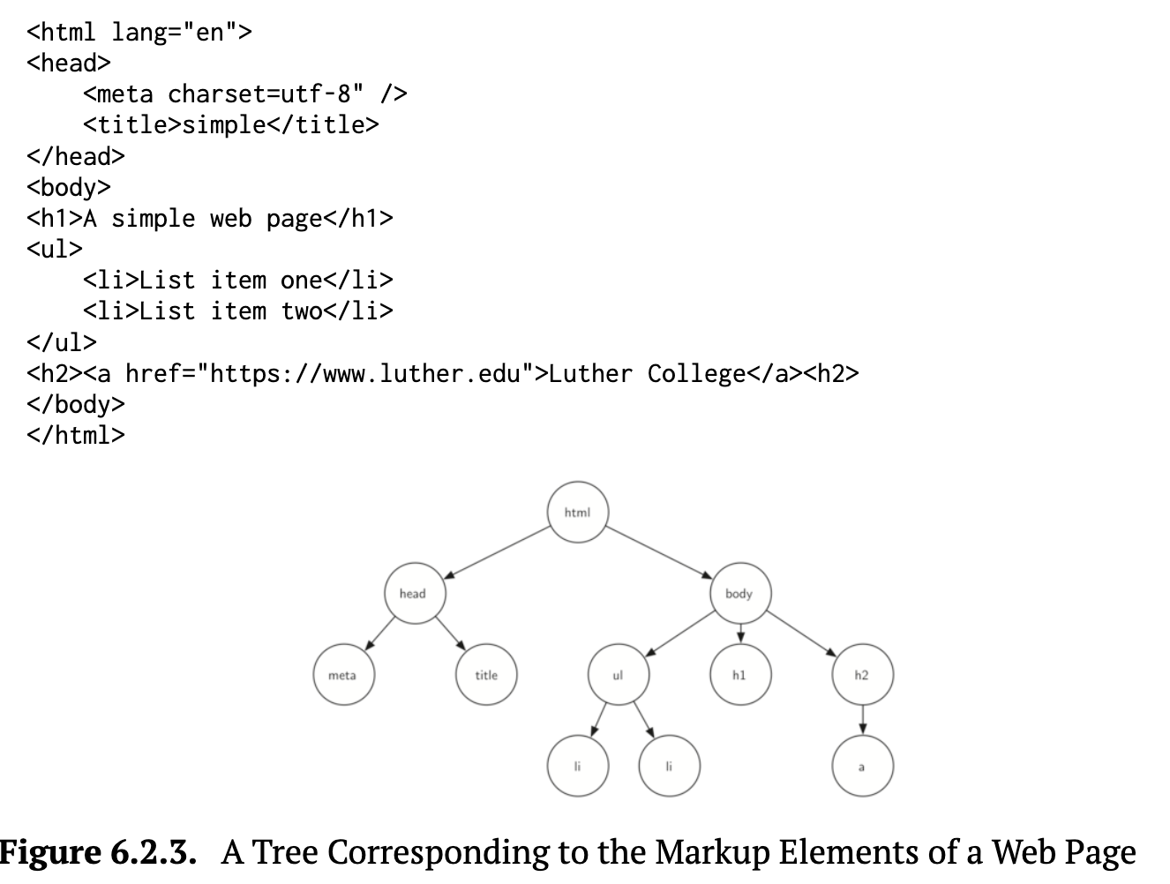
Trees
Linked lists, stacks, and queues are linear data structures while a Tree is a non-linear data structure
Comprised of a set of nodes
Nodes at lower levels are the children of the nodes at the previous level
A node can have only one parent, but may have multiple children
A leaf node is a node with no children
Root node is the top node of tree – it has no parent
6.2 Examples of Trees

Slide 5
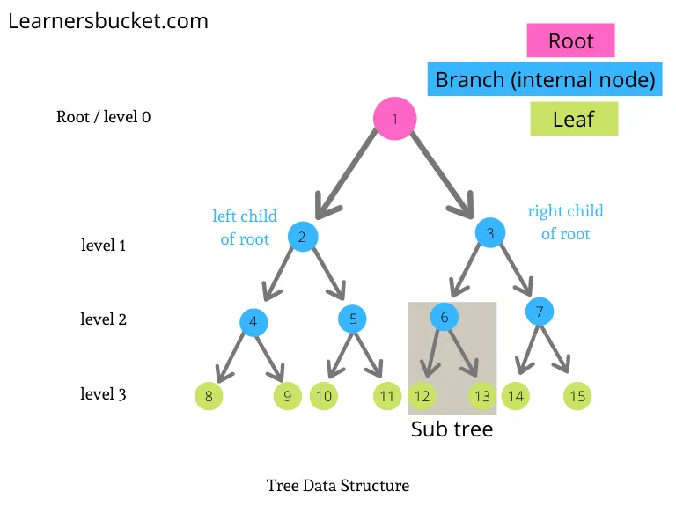
Binary Tree
In a binary each node contains two references (pointers or links) and contains
root node is the first node in a tree and has no parent.
Each link in the root node refers to a child.
left child is the first node in the left subtree where nodes reached through left reference (pointer) link
right child is the first node in the right subtree where does reached through right reference (pointer) link
The children of a node are called siblings.
A node with no children is called a leaf node.
Height is the longest possible path in a tree, from root to most distant node
binary trees

Slide 6
Applications of Binary Trees
These are not necessarily sorted, so they’re more about structure than search efficiency:
Expression Trees – Represent arithmetic expressions (e.g., postfix, prefix, infix conversions)
Decision Trees – Used in machine learning and games (e.g., game AI, classification models)
Syntax Trees – Used in compilers and interpreters
Organizational Trees – File systems, company org charts
Routing Tables – In networking protocols (as tree-like hierarchies)

Slide 7

Binary Search Tree (BST)
Binary search trees are a special kind of tree which follows the below rules,
Every Node should have a unique key.
The key in the left node should be less than the parent key.
The key in the right node should be greater than the parent key
The process of creating a binary search tree sorts the data (called binary tree sort)
Duplicates are eliminated during tree creation (duplicates may be included but cause complication)
A node can be inserted only as a leaf node in a binary search tree
Searching a binary search tree for a value is fast! O(log n)
The shape of the binary search tree that corresponds to a set of data can vary, depending on the order in which the values are inserted into the tree.

Slide 8
Binary Search Trees and Applications
We will focus binary search trees that
Why it's critical:
Efficient data organization and search (O(log n) average
More common in real-world applications
Introduces sorted data structures, search, insert, and delete
Basis for advanced topics: AVL trees, Red-Black trees, B-trees
Applications
Searching large sorted datasets – Like dictionaries, contact lists, database indexes
Symbol Tables – In compilers (maps variable names to values or memory locations)
Auto-complete suggestions – Store and lookup suggestions based on partial input
Range Queries – Retrieve all values between two numbers quickly
Priority structures – Support extensions like AVL trees, Red-Black Trees, Treaps, etc.

Slide 9
Connecting HashMaps to Trees
We have already seen how key-value pairs implementing a hashmap for the Map abstract data type (ADT).
Hash tables (HashMaps in Java) offer fast average-case lookup using a hash function, but do not maintain any ordering of keys.
In this section, we introduce Binary Search Trees (BSTs) as another way to implement the Map ADT. Unlike hash tables, BSTs maintain keys in sorted order, which allows for efficient range queries and in-order traversal.
While we are not focused on the exact placement of nodes in memory, the tree structure itself supports efficient searching, insertion, and deletion operations.

Slide 10
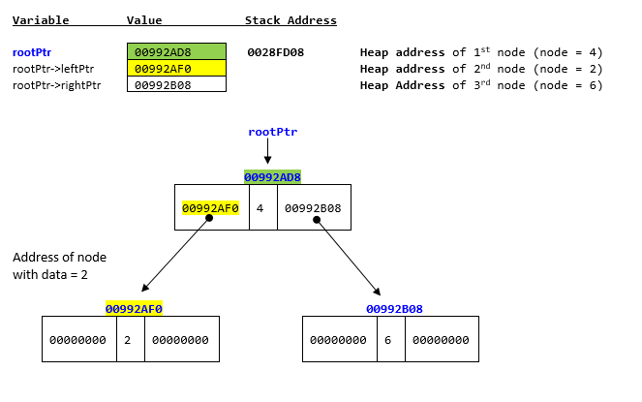
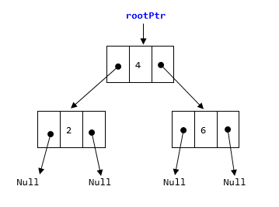
Create a Binary Search Tree
Open Binary Search Tree Visualizer and select Binary Search Tree - explore insert and search for this lecture.

Slide 11
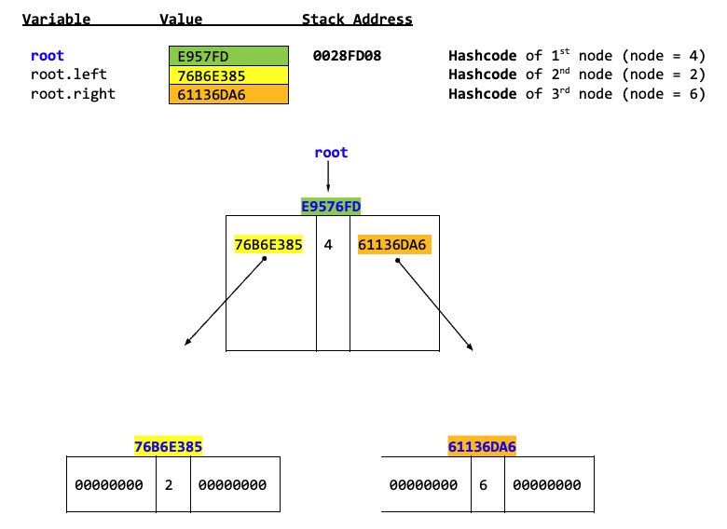
Tree Nodes
Each node contains 3 fields
Data field: The information the node holds
Left field: A reference to the child node in the left subtree
Right field: A reference to the child node in the right subtree
class TreeNode{
int data;
TreeNode left;
TreeNode right;
public TreeNode(int data){
this.data = data;
left = null;
right = null;
}
}
root.data = 4
root.left.data = 2
root.right.data = 6
Null
Null
Null
Null

Slide 12
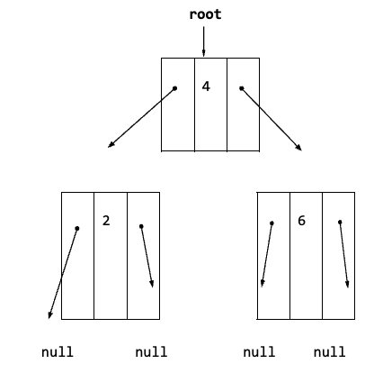
Building Binary Search Tree Class
Compare SinglyLinkedList (sorted) class code to the BinarySearchTree class code below.
class Node{
int data;
Node next;
public Node(int data){
this.data = data;
this.next = null;
}
}
class TreeNode{
int data;
TreeNode left;
TreeNode right;
public TreeNode(int data){
this.data = data;
left = null;
right = null;
}
}
For simplicity to introduce nodes class encapsulation was not implemented. You will see another way to implement later.
How would you describe what left and right are?
Write an algorithm on paper to insert nodes into a tree.
class SinglyLinkedList
{
Node head;
class BinarySearchTree{
private TreeNode root;
public BinarySearchTree(){
root = null;
}
Key in the left node should be less than the parent key and key in the right node should be greater than the parent key. There should not be duplicates

Slide 13
Insert
Copy this code Tree Insert non recursive and paste it in Online Java Compiler, Visual Debugger, and AI Tutor - Learn Java programming by visualizing code
Notice how information is stored in memory.
Did you approach it this way?
Would there be a better way to implement the insertion?

Slide 14
Project Iteration 02
https://docs.google.com/document/d/1SPiPj7Y-TCqHoF6AfrVojjQ_ua51XS2q9-S2zwnKGXA/edit?tab=t.0

Slide 15
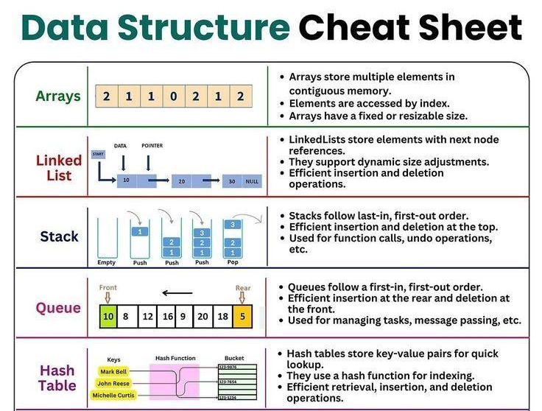
Preparation

